Slide 1
OBE Implementation
Module-1:University
Submitted By
Raja -> AP23110010694 vamsikrishnaraja_anna@srmap.edu.in
Koushik -> AP23110010695 koushik_ande@srmap.edu.in
Lokesh -> AP23110010705 lokeshramji_peethani@srmap.edu.in
Praveen -> AP23110011016 praveen_bapanapalli@srmap.edu.in
Mayank -> AP23110010704 mayank_singh@srmap.edu.in
Department : Btech ,Cse – O, 3rd semester

Slide 2
Introduction to Project
Our University (herewith considered as SRM-AP) is going to implement OBE(Outcome Based Education) in their university and you assigned in the project to develop an application with any programming Language you are well versed and you were supposed to do searching and sorting using learned algorithms,comparing your sorting algorithm with any one of existing algorithm,displaying the time complexity of both algorithms and explaining advantages and disadvantages of the algorithm

Slide 3
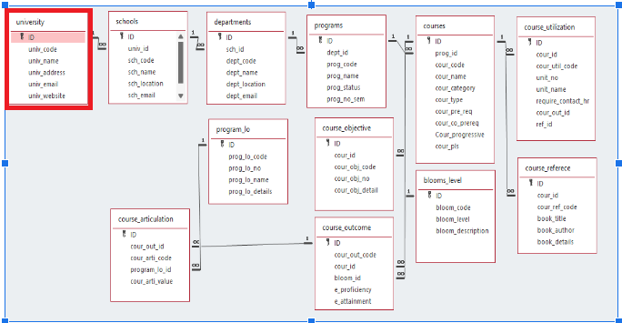
Architecture Diagram[*highlight your module as shown]

Slide 4
Module Description : University Setting
This module is used to create,Update,Retrieve,Delete(hereafter known as CURD) details of the module and storing the details in the text file.you have to provide option for searching and sorting of fields mentioned below according to algorithms given for you

Slide 5
University Setting:Field/table details
Field Name | Data type
id | integer
univ_code | String
univ_name | String
univ_address | String
univ_email | String
univ_website | String

Slide 6
University Setting:Programming Details
File name: university_data.txt
Function/method name
Create:V_Dart_university_create()
Update: V_Dart_university_ update()
Retrieve: V_Dart_university_retrieve()
Delete: V_Dart_university_delete()
Sorting: V_Dart_university_bubble_sort()
Searching: V_Dart_university_binary_search()
Storing: V_Dart_university_load_from_file()

Slide 7
University Setting:Programming Details
Comparison(both searching and Sorting):
For Searching- void V_Dart_university_binary_search(int id)
For Sorting-your void V_Dart_university_quick_sort(int low, int high)
Time Complexity(both searching and Sorting):
For Searching- V_Dart_university_display_time_complexities()
For Sorting-V_Dart_university_display_time_complexities()

Slide 8
University : Sorting Algorithm used and it’s Comparison
Sorting Algorithm Name: bubble sort.
Algorithm:
1.Start function V_Dart_university_bubble_sort().
2.Initialize two loop variables, i and j.
3.Declare a temporary variable temp of type uni to hold university data during swaps.
4.For each i from 0 to university_count - 2:
4.1 For each j from 0 to university_count - 2 - i:
4.1.1 If university[j].univ_Id is greater than university[j + 1].univ_Id:
4.1.1.1 Assign university[j] to temp.
4.1.1.2 Set university[j] to university[j + 1].
4.1.1.3 Set university[j + 1] to temp.
5.End function V_Dart_university_bubble_sort().
Sorting Algorithm Name: Quick sort.
Algorithm:
1.Start function V_Dart_university_quick_sort(low, high).
2.Check if low is less than high:
2.1 If true:
2.1.1 Set pivot to university[high].univ_Id.
2.1.2 Initialize i to low - 1.
2.1.3 For each j from low to high - 1:
2.1.3.1 If university[j].univ_Id is less than pivot:
2.1.3.1.1 Increment i by 1.
2.1.3.1.2 Set temp to university[i].
2.1.3.1.3 Assign university[j] to university[i].
2.1.3.1.4 Set temp to university[j].
2.1.4 Set temp to university[i + 1].
2.1.5 Assign university[high] to university[i + 1].
2.1.6 Set temp to university[high].
2.1.7 Set pi (pivot index) to i + 1.
2.1.8 Recursively call
V_Dart_university_quick_sort(low, pi - 1).
2.1.9 Recursively call
V_Dart_university_quick_sort(pi + 1, high).
3 .End function V_Dart_university_quick_sort()

Slide 9
University : Searching Algorithm used and it’s Comparison
Searching Algorithm Name: Linear search
Algorithm:
1.Start function V_Dart_university_linear_search(id).
2.For each i from 0 to university_count - 1:
2.1 If university[i].univ_Id is equal to id:
2.1.1 Return i (the index where the university with the matching univ_Id is found).
3.If the loop ends without finding a match,
return -1 (indicating the university was not found).
4.End function V_Dart_university_linear_search()
Searching Algorithm Name: Binary search
Algorithm:
1.Start function V_Dart_university_binary_search(id).
2.Initialize low to 0 and high to university_count - 1.
3.Repeat the following steps while low is less than or equal to high:
3.1 Calculate mid as low + (high - low) / 2.
3.2 If university[mid].univ_Id is equal to id:
3.2.1 Return mid (position of the university with matching univ_Id).
3.3 If university[mid].univ_Id is less than id:
3.3.1 Set low to mid + 1.
3.4 Otherwise (if university[mid].univ_Id is greater than id):
3.4.1 Set high to mid - 1.
4.If the loop ends without finding a match, return -1 (indicating the university was not found).
5. End function V_Dart_university_binary_search().

Slide 10
University : Time Complexity of Sorting Algorithm
Sl.No | Algorithm Name | Compared Algorithm
1 | Binary search [ o(log n) ] | Linear search [o(n)]
2 | Bubble sort [ o(n^2) ] | Quick sort [ o(n^2) ]

Slide 11
Sample Source Code[*Depict the routine of searching,Sorting,CRUDD and Storage options]
#include <stdio.h>
#include <stdlib.h>
#include <string.h>
#include <time.h>
#define max 100
struct University {
int univ_Id;
char univ_code[10];
char univ_name[20];
char univ_address[30];
char univ_email[15];
char univ_website[10];
} typedef uni;
uni university[max];
int university_count = 0;
const char *filename = "university_data.txt"; // Text file to store data
// Function to save data to a text file
void save_to_file() {
FILE *file = fopen(filename, "w"); // Open in write mode (text)
if (file == NULL) {
printf("Error opening file for writing.\n");
return;
}
fprintf(file, "%d\n", university_count); // Write count of universities
for (int i = 0; i < university_count; i++) {
fprintf(file, "%d %s %s %s %s %s\n", university[i].univ_Id,
university[i].univ_code, university[i].univ_name,
university[i].univ_address, university[i].univ_email,
university[i].univ_website); // Write each university's data
} fclose(file);
printf("Data saved to file successfully.\n");}

Slide 12
Sample Source Code[*Depict the routine of searching,Sorting,CRUDD and Storage options]
// Function to load data from a text file
void load_from_file() {
FILE *file = fopen(filename, "r"); // Open in read mode (text)
if (file == NULL) {
printf("No previous data found. Starting fresh.\n");
return;
}
fscanf(file, "%d", &university_count); // Read the count of universities
for (int i = 0; i < university_count; i++) {
fscanf(file, "%d %s %s %s %s %s", &university[i].univ_Id,
university[i].univ_code, university[i].univ_name,
university[i].univ_address, university[i].univ_email,
university[i].univ_website); // Read each
university's data } fclose(file);
printf("Data loaded from file successfully.\n");
}
void getuniversitydetails(uni *u) {
printf("Enter University ID: ");
scanf("%d", &u->univ_Id);
printf("Enter University Code: ");
scanf("%s", u->univ_code);
printf("Enter University Name: ");
scanf("%s", u->univ_name);
printf("Enter University Address: ");
scanf("%s", u->univ_address);
printf("Enter University Email: ");
scanf("%s", u->univ_email);
printf("Enter University Website: ");
scanf("%s", u->univ_website);
}
void showuniversitydetails(uni *u) {
printf("%d %s %s %s %s %s\n", u->univ_Id, u->univ_code, u->univ_name, u->univ_address, u->univ_email, u->univ_website);
}

Slide 13
Sample Source Code[*Depict the routine of searching,Sorting,CRUDD and Storage options]
// Bubble Sort for Sorting the universities by univ_Id
void bubble_sort() {
int i, j;
uni temp;
for (i = 0; i < university_count - 1; i++) {
for (j = 0; j < university_count - 1 - i; j++) {
if (university[j].univ_Id > university[j + 1]. univ_Id) {
temp = university[j];
university[j] = university[j + 1];
university[j + 1] = temp;
}
}
}
}
// Quick Sort for Sorting the universities by univ_Id
void quick_sort(int low, int high) {
if (low < high) {
int pivot = university[high].univ_Id;
int i = low - 1;
for (int j = low; j < high; j++) {
if (university[j].univ_Id < pivot) {
i++;
uni temp = university[i];
university[i] = university[j];
university[j] = temp;
}
}
uni temp = university[i + 1];
university[i + 1] = university[high];
university[high] = temp;
int pi = i + 1;
quick_sort(low, pi - 1);
quick_sort(pi + 1, high);
}
}

Slide 14
Sample Source Code[*Depict the routine of searching,Sorting,CRUDD and Storage options]
// Linear Search for a university by univ_Id
int linear_search(int id) {
for (int i = 0; i < university_count; i++) {
if (university[i].univ_Id == id) {
return i; // University found at index i
}
}
return -1; // University not found
}
// Binary Search for a university by univ_Id
int binary_search(int id) {
int low = 0, high = university_count - 1;
while (low <= high) {
int mid = low + (high - low) / 2;
if (university[mid].univ_Id == id) {
return mid;
}
if (university[mid].univ_Id < id) {
low = mid + 1;
} else {
high = mid - 1;
}
}
return -1; // University not found
}

Slide 15
Sample Source Code[*Depict the routine of searching,Sorting,CRUDD and Storage options]
void V_Dart_university_create() {
if (university_count >= max) {
printf("University List is Full\n");
return;
}
uni u;
getuniversitydetails(&u);
university[university_count++] = u;
save_to_file(); // Save data after adding
printf("University Created Successfully!\n");
}
void V_Dart_university_delete() {
if (university_count == 0) {
printf("University List not found\n");
return;
}
int id;
printf("Enter University ID to Delete: ");
scanf("%d", &id);
for (int i = 0; i < university_count; i++) {
if (university[i].univ_Id == id) {
for (int j = i; j < university_count - 1; j++) {
university[j] = university[j + 1];
}
university_count--;
save_to_file(); // Save data after deletion
printf("University deleted successfully!\n");
return;
}
}
printf("University with ID %d not found.\n", id);}

Slide 16
Sample Source Code[*Depict the routine of searching,Sorting,CRUDD and Storage options]
void V_Dart_university_update() {
if (university_count == 0) {
printf("University List not found\n");
return;
}
int id;
printf("Enter University ID to Update: ");
scanf("%d", &id);
for (int i = 0; i < university_count; i++) {
if (university[i].univ_Id == id) {
printf("Enter details of ID %d again\n", id);
getuniversitydetails(&university[i]);
save_to_file(); // Save data after updating
printf("University updated successfully!\n");
return;
}
}
printf("University with ID %d not found.\n", id);
}
void V_Dart_university_retrieve() {
if (university_count == 0) {
printf("University List is Empty\n");
return;
}
for (int i = 0; i < university_count; i++) {
showuniversitydetails(&university[i]);
}
}
void display_time_complexities() {
printf("\nTime Complexities:\n");
printf("1. Bubble Sort: O(n^2)\n");
printf("2. Quick Sort: O(n log n) (on average)\n");
printf("3. Linear Search: O(n)\n");
printf("4. Binary Search: O(log n) (requires sorted data)\n");
}

Slide 17
Sample Source Code[*Depict the routine of searching,Sorting,CRUDD and Storage options]
int main() {
load_from_file(); // Load data at the start of the program
int choice;
do {
printf("\n--- University Management System ---\n");
printf("1. Create University\n");
printf("2. Delete University\n");
printf("3. Update University\n");
printf("4. Retrieve University List\n");
printf("5. Sort Universities (Bubble Sort)\n");
printf("6. Sort Universities (Quick Sort)\n");
printf("7. Search University (Linear Search)\n");
printf("8. Search University (Binary Search)\n");
printf("9. Display Time Complexities\n");
printf("10. Exit\n");
printf("Enter your choice: ");
scanf("%d", &choice);
switch (choice) {
case 1:
V_Dart_university_create();
break;
case 2:
V_Dart_university_delete();
break;
case 3:
V_Dart_university_update();
break;
case 4:
V_Dart_university_retrieve();
break;
case 5: {
clock_t start = clock();
bubble_sort();
clock_t end = clock();
double time_taken = ((double)end - start) / CLOCKS_PER_SEC;
printf("Bubble Sort Time: %f seconds\n", time_taken);
break;
}

Slide 18
Sample Source Code[*Depict the routine of searching,Sorting,CRUDD and Storage options]
case 6: {
clock_t start = clock();
quick_sort(0, university_count - 1);
clock_t end = clock();
double time_taken = ((double)end - start) / CLOCKS_PER_SEC;
printf("Quick Sort Time: %f seconds\n", time_taken);
break;
}
case 7: {
int id;
printf("Enter University ID to search: ");
scanf("%d", &id);
clock_t start = clock();
int result = linear_search(id);
clock_t end = clock();
double time_taken = ((double)end - start)/ CLOCKS_PER_SEC;
if (result != -1)
printf("University found at index: %d\n", result);
else
printf("University not found\n");
printf("Linear Search Time: %f seconds\n", time_taken);
break;}
case 8: {
int id;
printf("Enter University ID to search: ");
scanf("%d", &id);
clock_t start = clock();
int result = binary_search(id);
clock_t end = clock();
double time_taken = ((double)end - start) / CLOCKS_PER_SEC;
if (result != -1)
printf("University found at index: %d\n", result);
else
printf("University not found\n");
printf("Binary Search Time: %f seconds\n", time_taken);
break;
}
case 9:
display_time_complexities();
break;

Slide 19
Sample Source Code[*Depict the routine of searching,Sorting,CRUDD and Storage options]
case 10:
printf("Exiting...\n");
break;
default:
printf("Invalid choice! Please enter a valid option.\n");
}
} while (choice != 10);
return 0;
}

Slide 20
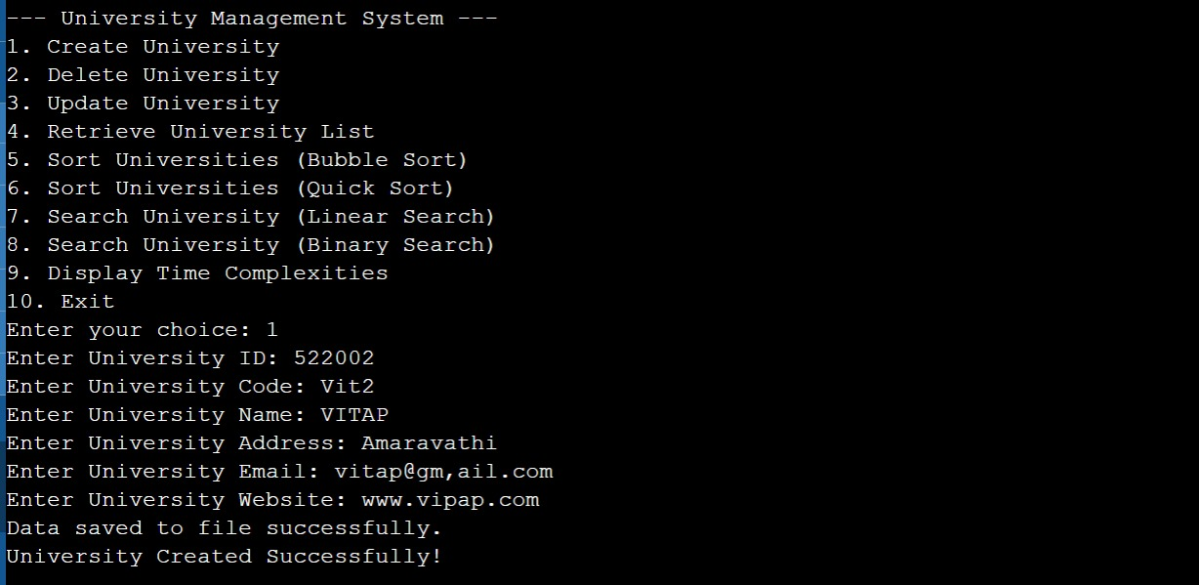
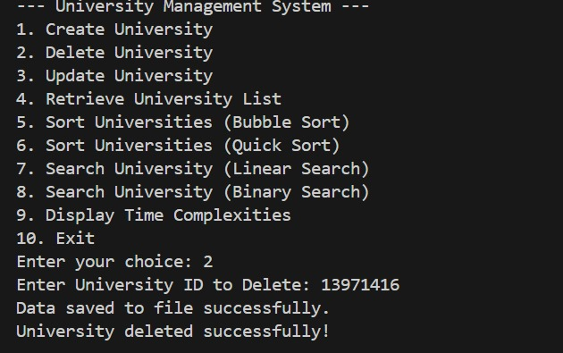
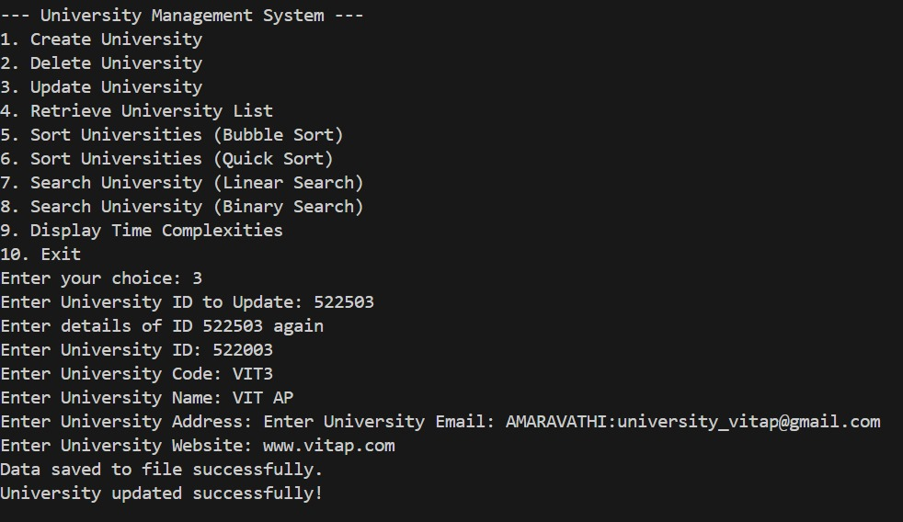
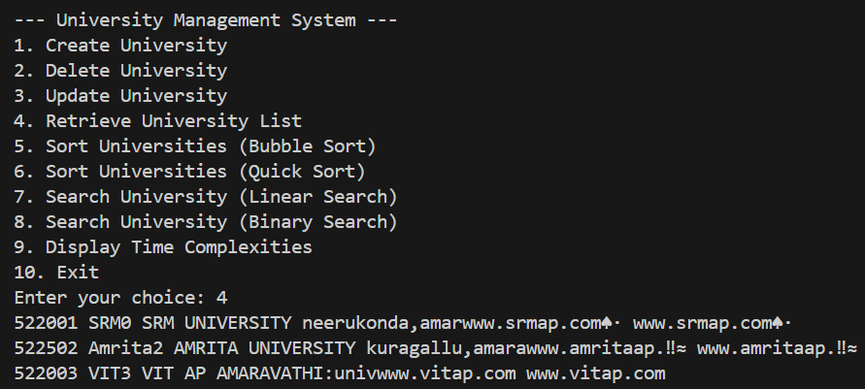
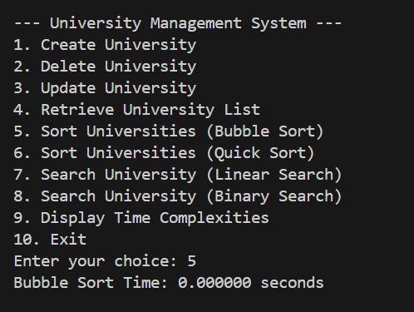
Sample Screen Shots[*Screen shot of CRUD,Sorting,Searching,Comparison(both sorting and Searching and Storage)]

Slide 21
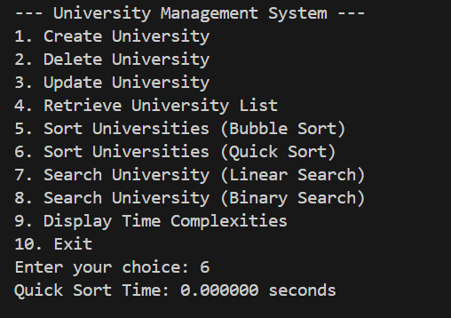
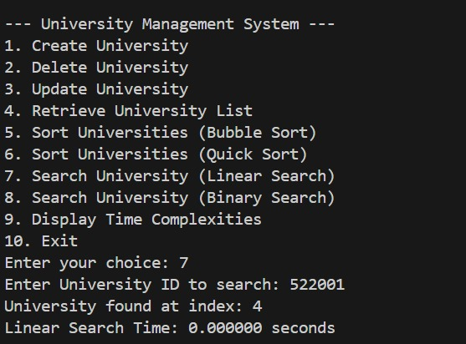
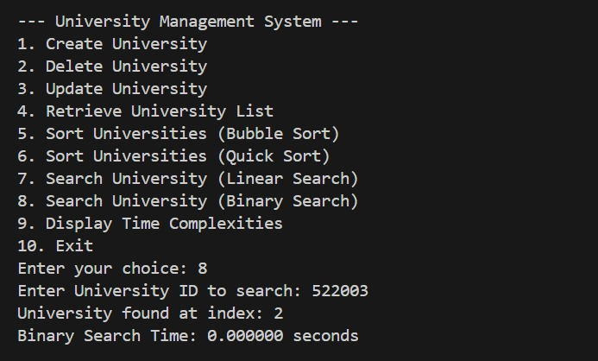
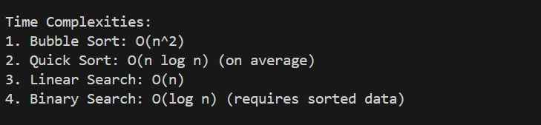
Sample Screen Shots[*Screen shot of CRUD,Sorting,Searching,Comparison(both sorting and Searching and Storage)]

Slide 22
Conclusion
The University Management System effectively demonstrates the use of basic algorithms and data manipulation strategies in the school's and educational institution's data organization and management. By integrating sorting algorithms like Bubble Sort and Quick Sort with searching algorithms like Linear and Binary Search, it proposes efficient and scalable solutions for data retrieval and management. Data persistence improves with the system's ability to save and load the data from a file, thus providing reliability and usability following program termination.

Slide 23
Thank You

